Slide 1
BSc II
CHEM DSE 202
GROUP 13
BORON FAMILY( Part I)

Slide 2
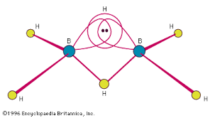
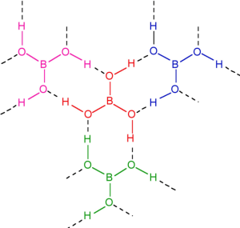
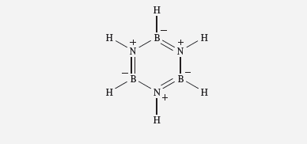
Topics covered
Introduction to hydrides of boron
Diborane
Borazine
Boric Acid

Slide 3
Hydrides of boron
The hydrides of boron are called boranes in analogy to the hydrides of carbon called Alkanes
There are two categories of boranes as regards formula
BnHn+4 and BnHn+6
Example B2H6 and B4H10

Slide 4
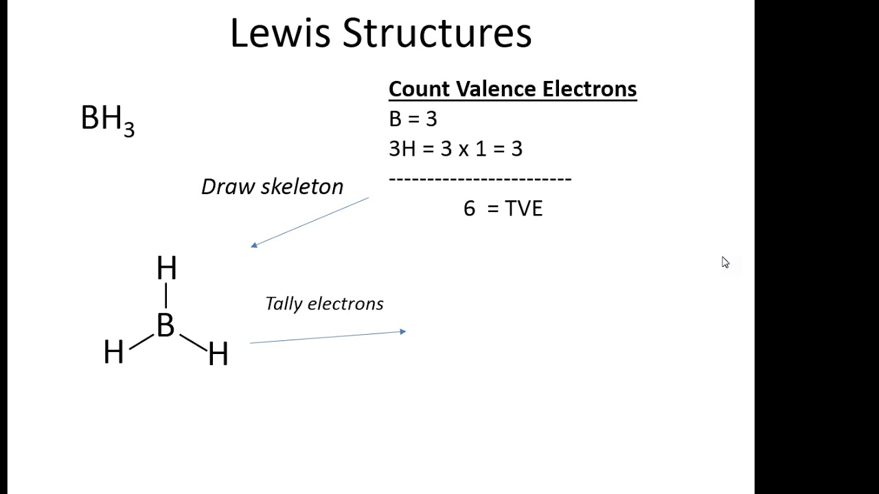
DIBORANE (B₂H₆)
The simplest hydride of boron is BH₃ (BORANE)
In BH₃ central boron atom has total of six valence electrons and is electron deficient species ,so it exists as a dimer B₂H₆ called diborane .

Slide 5
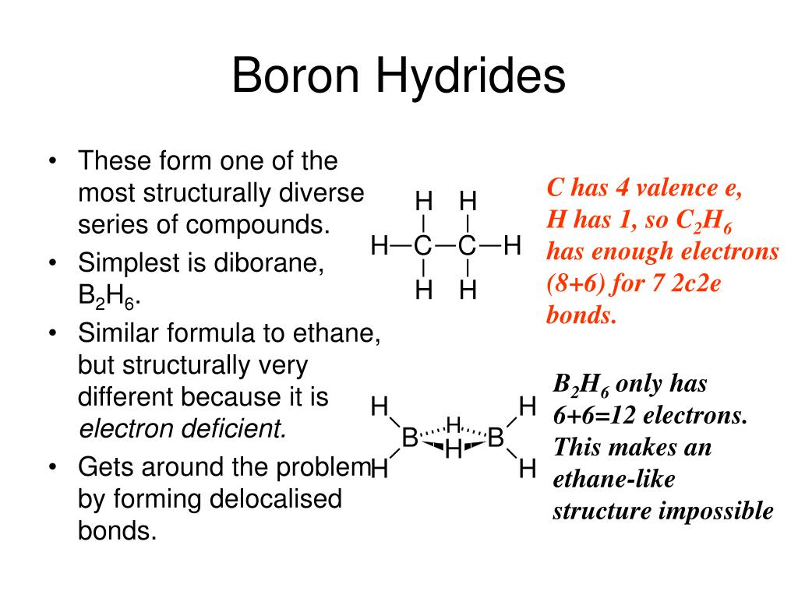
STRUCTURE AND BONDING IN DIBORANE
B₂H₆ is like its analogous partner in alkanes i.e Ethane C₂H₆ .But there is a difference in structure and bonding between the two.This is because total valence electrons in diborane is 12 whereas in ethane it is 14.
Since diborane has two electrons less than that required for covalent bond formation between adjacent pair of atoms ,so it is an electron deficient compound.

Slide 6
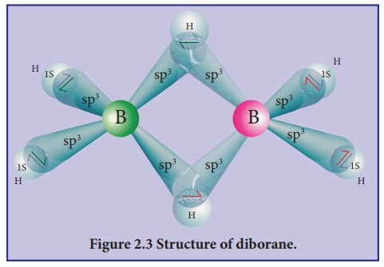
Structure of diborane
Each boron atom undergoes sp3 hybridisation .Out of the four hybrid sp3 orbitals ,three have one electron each and fourth hybrid orbital is empty.
Two hybrid orbitals (with one electron)from each boron form two bonds with two hydrogen atoms .
These are normal 2c-2e B-Ht bonds where Ht means terminal hydrogen atoms.So we have 4 such B-Ht bonds in diborane

Slide 7
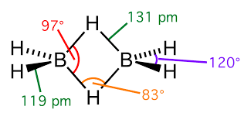
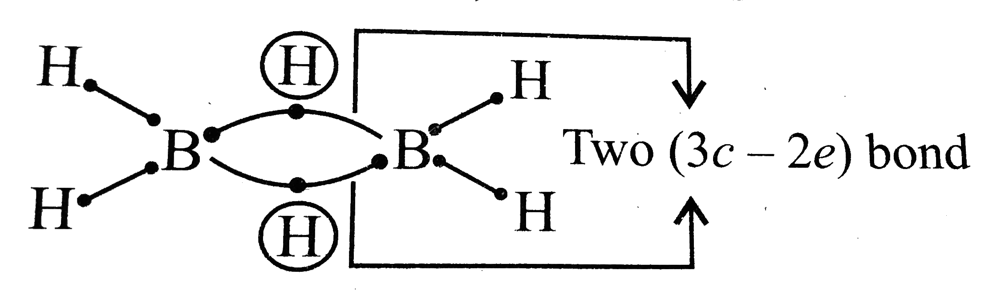
Structure
Now the third sp³ HO on one boron having one electron ,one hydrogen atom (1s orbital) having one electron and one sp³ vacant orbital from second boron overlap to give 3 centres and only two electrons.
This forms one B-H-B bond and such hydrogen is bridged hydrogen and bond is 3c-2e B-H-B BOND or BANANA BOND(due to its shape)
We have two such bonds in diborane as seen in figure.

Slide 8
Preparation of DIBORANE
The industrial synthesis of diborane involves the reduction of BF₃ by sodium hydride, lithium hydride or lithium aluminium hydride:^{[10]}
8 BF₃ + 6 LiH → B₂H₆ + 6 LiBF₄
Two laboratory methods start from boron trichloride with lithium aluminium hydride or from boron trifluoride ether solution with sodium borohydride. Both methods result in as much as 30% yield:
4 BCl₃ + 3 LiAlH₄ → 2 B₂H₆ + 3 LiAlCl₄
4 BF₃ + 3 NaBH₄ → 2 B₂H₆ + 3 NaBF₄

Slide 9
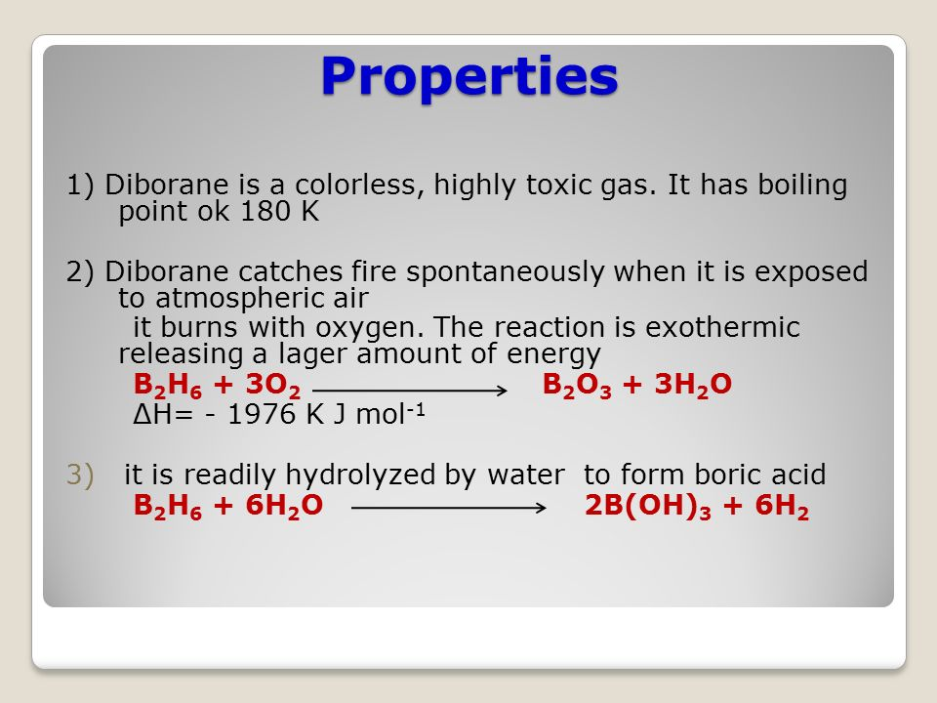
Properties of diborane

Slide 10
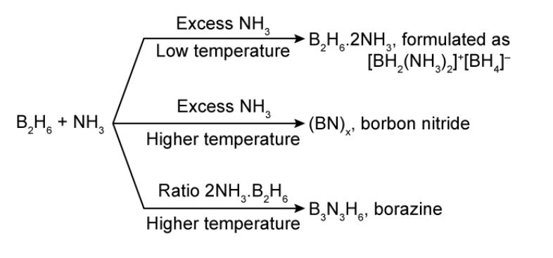
Reactions of diborane with ammonia

Slide 11
Reactions of diborane
With alcohols it forms borates
B₂H₆+ 6CH₃OH B(OCH₃)₃ + 6H₂
With ethers it forms addition compounds
B₂H₆ +CH₃OCH₃ 2[H₃B O(CH₃)₂]
With CO it forms addition product borine carbonyl
B₂H₆ + 2CO 2BH₃ .CO
With alkenes it forms alkyl boranes in presence of ether (Hydroboration reaction)
B₂H₆ + CH₂ = CH₂ 2 (RCH₂-CH₂)₃B
These alkyl boranes form primary alcohols on oxidation with hydrogen peroxide

Slide 12
REACTIONS OF DIBORANE
With halogen acids
B₂H₆ +HI B₂H₅I +H₂
With alkalies ,metaborates are formed
B₂H₆+ 2NaOH +2H₂O 2NaBO₂ +6H₂
With pyridine :Addition product is formed
B₂H₆ + 2C₅H₅N [2BH₃ NC₅H₅]
Diborane when heated above 100⁰C ,gives higher boranes LIKE B₄H₁₀,B₅H₉,B₅H₁₁

Slide 13
BORAZINE
B₃N₃H₆ is Borazine or inorganic benzene or borazole.
It is called inorganic benzene because it is isoelectronic with benzene and has structure and some physical properties similar to benzene
Borazine is also called borazole

Slide 14
Preparation of Borazine
It is prepared by the reaction of diborane with ammonia in the ratio of 1:2 at high temperature.
B₂H₆ + 6NH₃ 300⁰ B₃N₃H₆ + 12H₂

Slide 15
Structure of borazine
Borazine has planar structure .Each boron and nitrogen atom is sp2 hybridised .
Each boron has a vacant p orbital and each nitrogen atom has lone pair of electron on unhybridised p orbital.
There is sidewise overlap of vacant p orbital of boron and filled p orbital of Nitrogen atom resulting in three dative bonds.
There is thus polarity in B-N bonds unlike benzene and so borazine is less aromatic and more reactive than benzene

Slide 16
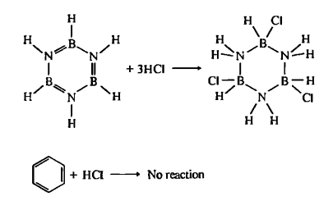
PROPERTIES OF BORAZINE
B₃N₃H₉Cl₃
It is a colourless liquid with boiling point 55⁰C
It is more reactive than benzene and undergoes addition reactions easily.
Reacts with water and alcohol to give addition products
B₃N₃H₆ +3H₂O [BH(OH)NH₂]₃ +3H₂
With HCl it gives addition product
B₃N₃H₆ +3HCL B₃N₃H₉Cl₃
This on heating gives B Trichloroborazine

Slide 17
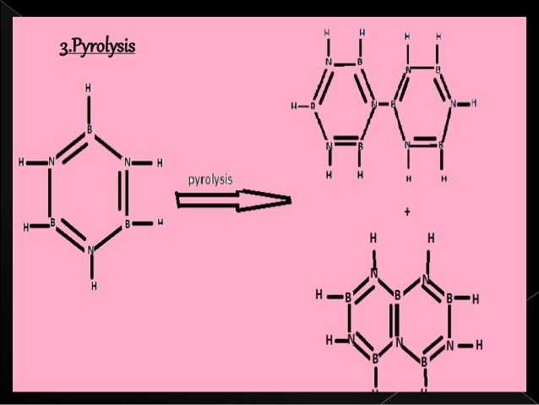
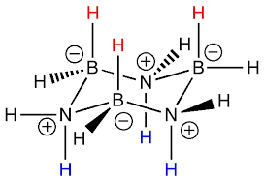
Analogues of cyclohexane,Naphthalene and Biphenyl
With NaBH₄ ,B₃N₃H₉Cl₃ gives B₃N₃ H₁₂ ,analogue of C₆ H₁₂ (CYCLOHEXANE)
CHAIR FORM OF B₃N₃ H₁₂
B₃N₃ H₁₂
Borazine on pyrolysis give inorganic Naphthalene and inorganic biphenyl

Slide 18
OXYACID OF BORON(BORIC ACID)
B(OH)₃ or H₃BO₃ is boric acid .It is the most common oxyacid of boron ,also known as orthoboric acid
Preparation: It is the end product of hydrolysis of most boron compounds.
B₂H₆ + 6H₂O H₃BO₃ + 3H₂
B₂O₃ + H₂O H₃BO₃
On large scale it obtained from borax
Na₂B₄O₇ +2HCl + 5H₂O 4H₃BO₃ + 2NaCl

Slide 19
Properties of boric acid
It is white ,flaky,transparent crystalline solid
It readily dissolves in hot water
It is a weak monobasic acid .
When titrated against strong base NaOH ,the end point is not sharp because sodium tetrahedral metaborate formed during neutralisation gets hydrolysed easily and reaction moves in backward direction.

Slide 20
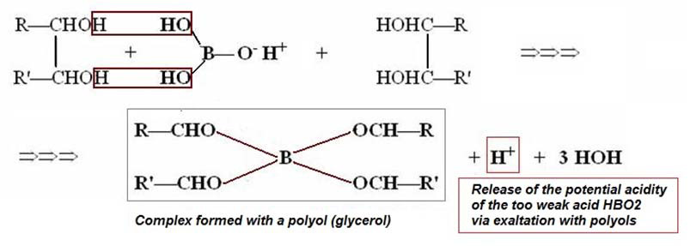
In presence of glycerol ,sharp end point given by boric acid
In presence of glycerol,boric acid gives sharp end point when titrated with NaOH .
This is due to the chelate complex formed by glycerol with tetrahedral metaborate.The chelate complex makes the equilibrium reaction move in the forward direction and all boric acid reacts with NaOH
.This is equivalent to reaction of strong acid with strong base.So end point is sharp.

Slide 21
Properties of Boric Acid
With alcohol in presence of conc H₂SO₄ ,alkyl borates are formed.
H₃BO₃ + 3C₂H₅OH B(OC₂H₅)₃
Triethyl borate is volatile ,when ignited burns with green flame (QUALITATIVE ANALYSIS OF BORATE ION)
Action of heat
At 100⁰C metaboric acid HBO₂ is formed which on heating at 160⁰C gives tetraboric acid H₂B₄O₇ which on heating further Forms B₂O₃.

Slide 22
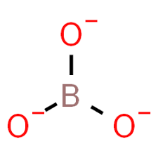
STRUCTURE OF BORIC ACID
Orthoboric acid contains triagonal planar BO₃³⁻ UNITS .
Each such unit sp² hybridised boron atom which is attached to three O- atoms at the corners of equilateral triangle.

Slide 23
2D STRUCTURE OF BORIC ACID
In orthoboric acid all these units are held together through hydrogen bonds in a 2D SHEET FORM.

Slide 24
Kindly try to write answers to following questions
Q1 Boron is trivalent in its compounds Comment
Q2 Boron does not form B³⁺ ion (T/F)
Q3 BH3 does not exist free. Comment
Q4 What happens when boric acid is heated to redness?
Q5 What is 3c-2e bond?Why is it called banana bond?
NEXT TOPIC : BORON FAMILY (PART II)

